Slide 1
Introduction to Physical Science
Alcohols & Ethers
Presented by Robert Wagner

Slide 2
Alcohols
An alcohol is a hydrocarbon in which the hydrogen atom has been replaced by an -OH group
This is not a base even though it has the -OH
Bonding with carbon is a covalent bond and not an ionic bond as in the bases like NaOH
Ethanol - the alcohol in beer, wine and other drinks
Fermented sugars
Image Credit: OpenStax Chemistry Chapter 20.2 CC BY 4.0

Slide 3
Naming Alcohols
Name comes from the underlying hydrocarbon structure
The final -e in the name of the hydrocarbon is replaced by -ol
The number indicates the carbon atom to which the -OH group is bonded
Number of carbon atoms?
5 = Pentane (if no -OH)
Becomes Pentanol
2-Pentanol since the -OH group is bonder to carbon atom #2
Image Credit: OpenStax Chemistry Example 20.8 CC BY 4.0

Slide 4
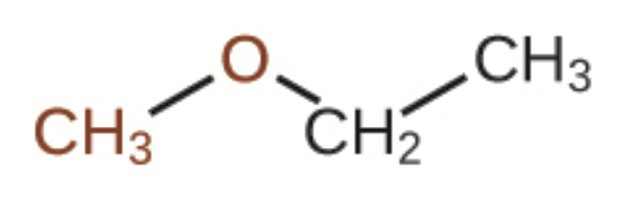
Ethers
Ethers are hydrocarbons with a functional group -O-
IUPAC name:
The smaller group gets -oxy added to it
Continue with the larger carbon chain
Common name:
Two branches named separately followed by ether
methoxy
methoxyethane
ethylmethyl ether
Image Credit: OpenStax Chemistry Table 20.1 CC BY 4.0

Slide 5
Example
Provide the IUPAC and common name for the ether shown here:
Both sides have two carbon atom chains
Ethane
So, ethoxyethane would be the IUPAC name
Both are ethyl groups, so the common name would be:
Diethyl ether
Image Credit: OpenStax Chemistry Example 20.9 CC BY 4.0

Slide 6
Summary
Alcohols - hydrocarbon base with a hydrogen replaced by an -OH group
Ethers - hydrocarbons with an -O- functional group
Compounds have multiple names - an IUPAC name as well as a common name

