Slide 1
Introduction to Physical Science
Aldehydes, Ketones, Carboxylic Acids, & Esters
Presented by Robert Wagner

Slide 2
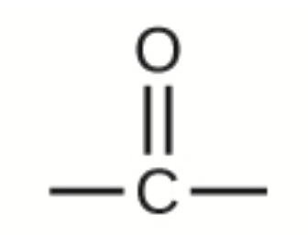
Aldehydes & Ketones
The aldehydes and ketones contain a carbonyl group
This is a functional group with a carbon-oxygen double bond
Naming - use the following suffixes
Aldehydes -al
Keytones - -one
Image Credit: OpenStax Chemistry Chapter 20.3 CC BY 4.0

Slide 3
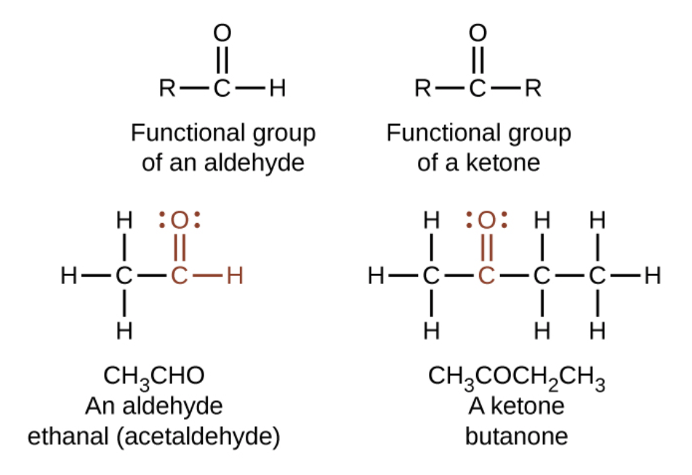
Aldehydes & Ketones
The aldehydes and ketones contain a carbonyl group
This is a functional group with a carbon-oxygen double bond
Naming - use the following suffixes
Aldehydes -al
Keytones - -one
Image Credit: OpenStax Chemistry Chapter 20.3 CC BY 4.0

Slide 4
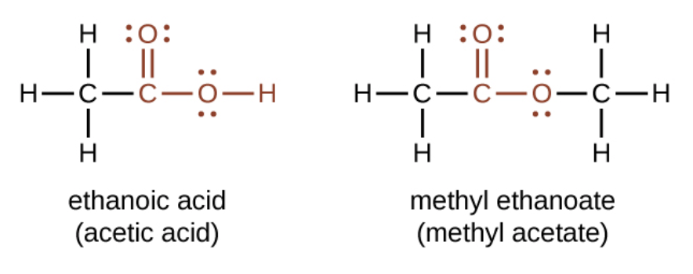
Carboxylic Acids and Esters
Contain a carbonyl group with a second oxygen atom
In a carboxylic acid, the second oxygen atom is bonded to a hydrogen atom
In an ester, the second oxygen atom is bonder to another carbon atom
Image Credit: OpenStax Chemistry Chapter 20.3 CC BY 4.0

Slide 5
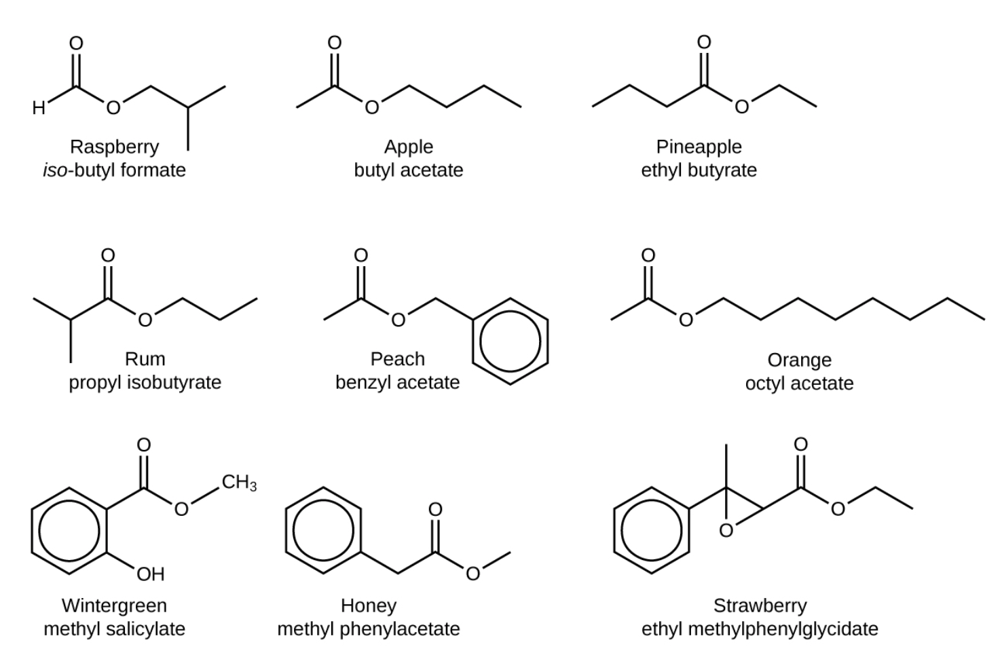
Esters
Many scents
Have low vapor pressure since they do not have hydrogen bonds between molecules
Image Credit: OpenStax Chemistry Example 20.8 CC BY 4.0

Slide 6
Discussion
Simplest carboxylic acid:
$HCO_{2}H$ - Formic Acid
Causes pain and irritation from ant and wasp sitings
Acetic Acid - Vinegar
$$CH_{3}CO_{2}H$$
Flowers, perfumes and fruits
Aroma due to the presence of one or more esters

Slide 7
Summary
Aldehydes & Ketones contain a functional group with a carbon-oxygen double bond
Carboxylic Acids & Esters contain a carbonyl group with a second oxygen atom bonded to the carbonyl group
Esters are responsible for many of the scents with which we are familiar

