Slide 1
Introduction to Physical Science
Amines & Amides
Presented by Robert Wagner

Slide 2
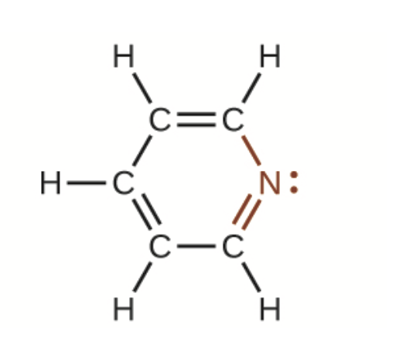
Amines
Amines - molecules with carbon-nitrogen bonds
Nitrogen retains a pair of electrons and three bonds to either carbon or hydrogen atoms
Naming involves -ine suffix
Pyridine
Nitrogen atom replaces one of the carbon atoms in an aromatic hydrocarbon
Image Credit: OpenStax Chemistry Figure 20.17 CC BY 4.0

Slide 3
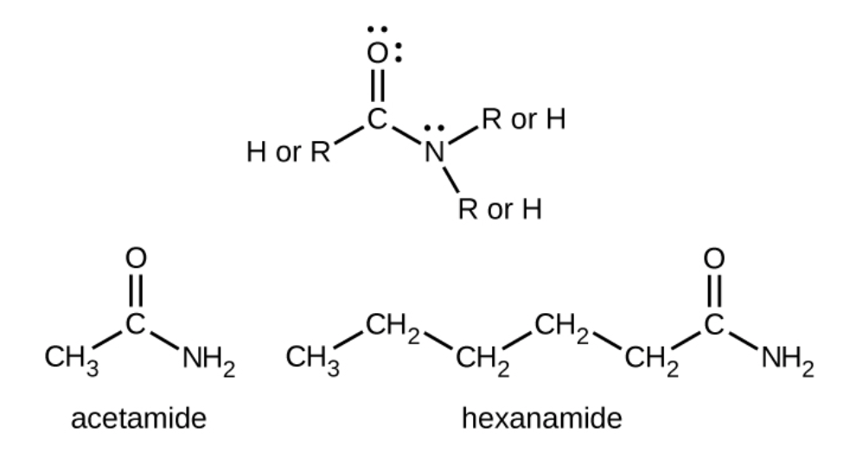
Amides
Amides - contain nitrogen atoms which are bonded to the carbon atom of a carbonyl group
Naming includes suffix -amide
Image Credit: OpenStax Chemistry Chapter 20.4 CC BY 4.0

Slide 4
Carboxylic Acids and Amides
Amides can be produced when a carboxylic acid reacts with an amine
Image Credit: OpenStax Chemistry Chapter 20.4 CC BY 4.0

Slide 5
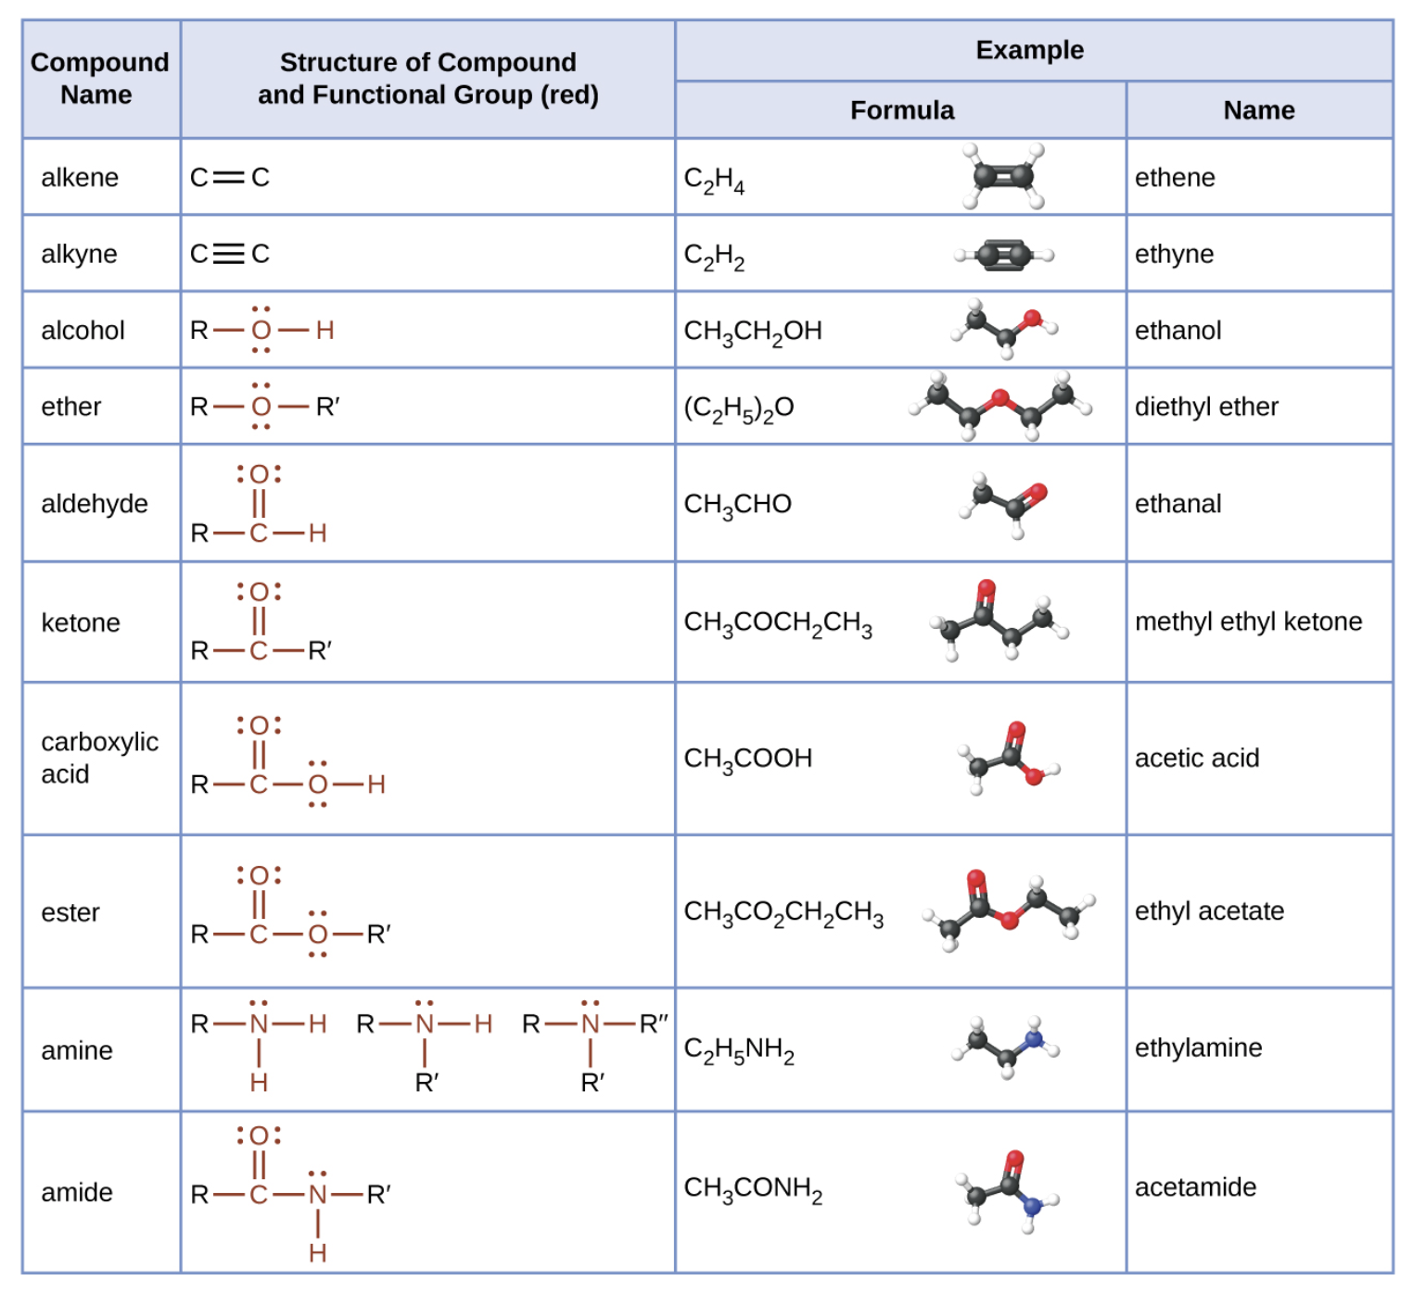
Review of Organic Molecules
Image Credit: OpenStax Chemistry Chapter 20.4 CC BY 4.0

Slide 6
Summary
Amines are molecules with carbon-nitrogen bonds
In amides, the nitrogen is bonded to the carbon in a carbonyl group
Amides can be produced when an amine reacts with a carboxylic acid

