Slide 1
Introduction to Physical Science
Nuclear Structure
Presented by Robert Wagner

Slide 2
Nuclear Reactions
What we have studied so far involves the electrons in an atom
Nuclear reactions are changes that occur within the nucleus of an atom
Recall:
Atoms have a nucleus consisting of protons and neutrons
Z = Atomic number = number of protons
A = Atomic mass = number of protons + number of neutrons
${}_{6}^{14}C$ - A = 14, Z = 6 ; Also called Carbon-14
Nucleons - term to refer to nuclear particles - both protons and neutrons

Slide 3
Example
What is the density of a neutron star with a mass of 2.4 solar masses (1 solar mass = 1.99x10³⁰ kg) and a diameter of 26 kilometers?
$$m=2.4x1.99x{10}^{30}kg=4.776x{10}^{30}kg$$
$$r=13km=13000m$$
$$ρ=\frac{m}{V};V=\frac{4}{3}πr^{3}$$
$$ρ=\frac{4.776x{10}^{30}kg}{\frac{4}{3}π(13000)^{3}}$$
$$ρ=5.2x{10}^{17}kg/m^{3}$$

Slide 4
Nuclear Force
Strong nuclear force - one of the four fundamental forces of nature
Acts between nucleons in the nucleus
Much stronger than the electrostatic forces at the very small, nuclear distances
Nuclear binding energy
Energy produced when the nucleons are bound together
These are much greater than the chemical bond energies
Mass defect
Difference between calculated and measured mass of a nucleus
Can be equated to energy through: $E=mc^{2}$

Slide 5
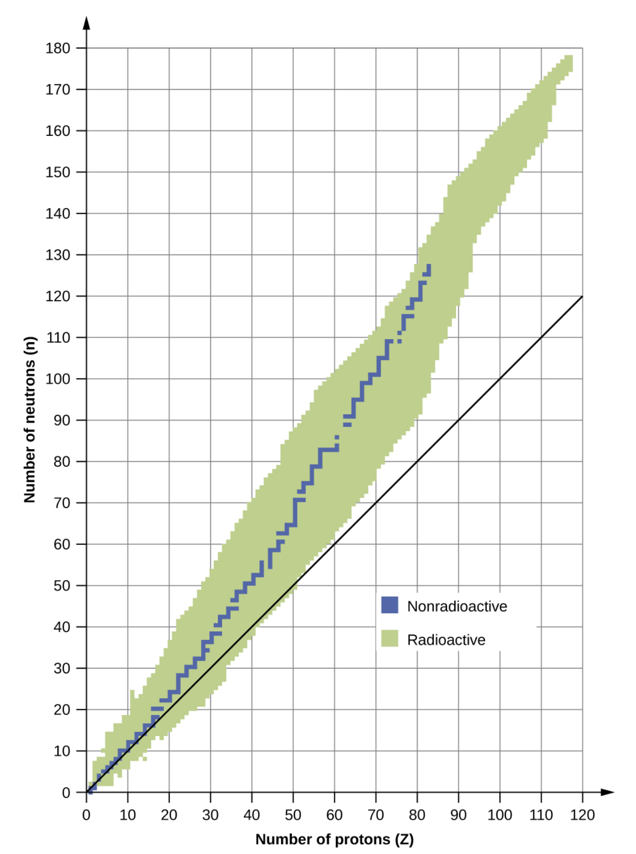
Nuclear Stability
Only a small percentage of nuclei that exist are stable
Fall in “Band of Stability”
Stable nuclei of higher mass will have more neutrons than protons
Needed to keep nucleus bound together
Radioactive nuclei
Around band of stability
Will decay in to another isotope
Image Credit: OpenStax Chemistry Figure 21.2 CC BY 4.0

Slide 6
Nuclear Stability (2)
Nuclei with even numbers of protons and neutrons are more likely to be stable
Magic numbers
Specific numbers of protons or neutrons are stable against decay
2, 8, 20, 28, 50, 82, and 126
Double magic - Extremely stable isotopes
$${}_{2}^{4}He;{}_{8}^{16}O;{}_{20}^{40}Ca;{}_{82}^{208}Pb$$
Image Credit: OpenStax Chemistry Table 21.1 CC BY 4.0 CC BY 4.0

Slide 7
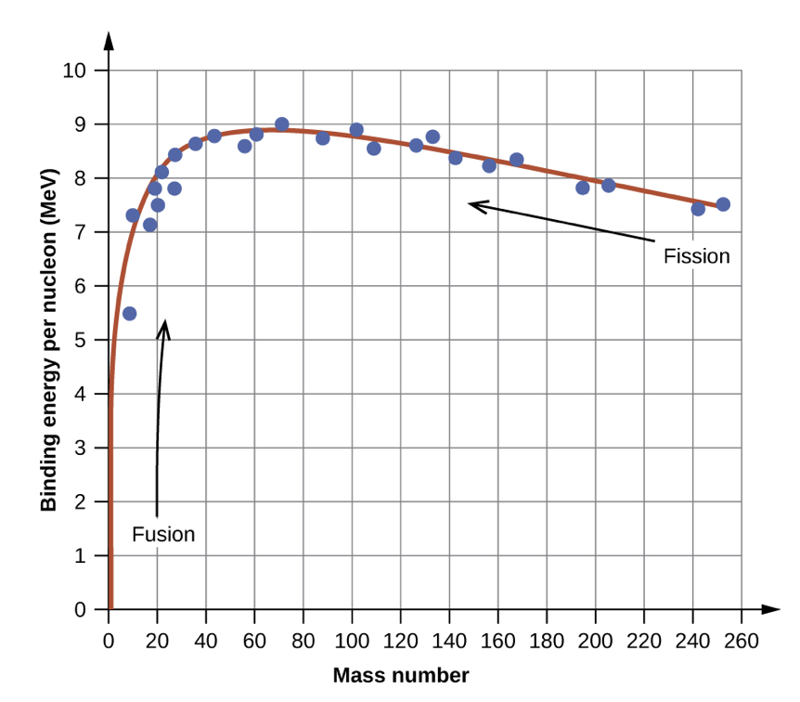
Binding Energy per Nucleon
Divide the total binding energy of the nucleus by the number of nucleons
Energy gain by nuclear fusion
Move from lower mass nuclei to higher mass nuclei
Energy gain from nuclear fission
Move from higher mass nuclei to lower mass nuclei
${}_{26}^{56}Fe$ - highest binding energy per nucleon
Electron volt (eV) used to measure nuclear binding energies
$$1eV=1.602x{10}^{-19}J$$
Image Credit: OpenStax Chemistry Figure 21.3 CC BY 4.0

Slide 8
Example
26 protons, 30 neutrons, 26 electrons
Mass defect:
$$=[(26x1.0073amu)+30x1.0087amu$$
$$+(26x0.00055amu)]-55.9349amu$$
$$=0.5302amu$$
$$E=mc^{2}=0.5302amux\frac{1.6605x{10}^{-27}kg}{amu}x(2.998x{10}^{8}m/s)^{2}$$
$$E=7.913x{10}^{-11}J$$
$$7.913x{10}^{-11}Jx\frac{1MeV}{1.602x{10}^{-13}J}=493.9MeV$$
$$\frac{493.9MeV}{56}=8.820MeV/nucleon$$
${}_{26}^{56}Fe$ has the highest binding energy per nucleon - what is this binding energy (in MeV/nucleon)? (Atomic mass = 55.9349 amu)
Image Credit: OpenStax Chemistry Figure 21.3

Slide 9
Summary
In nuclear reactions, we look at the changes in nuclear structure
The nuclear binding energy is the energy needed to break the nucleus in to its components
Stable atomic nuclei tend to have even numbers of protons and neutrons

