Slide 1
Introduction to Physical Science
Nuclear Equations
Presented by Robert Wagner

Slide 2
Types of Particles in Nuclear Reactions
Recall: Nuclear reactions involve changes in atomic numbers, mass numbers, or energy states of nuclei
Particles:
Protons: ${}_{1}^{1}p$
Neutrons: ${}_{0}^{1}n$
Alpha Particles: ${}_{2}^{4}He$
Beta Particles: ${}_{-1}^{0}βor{}_{-1}^{0}e$
Positrons: ${}_{+1}^{0}βor{}_{+1}^{0}e$

Slide 3
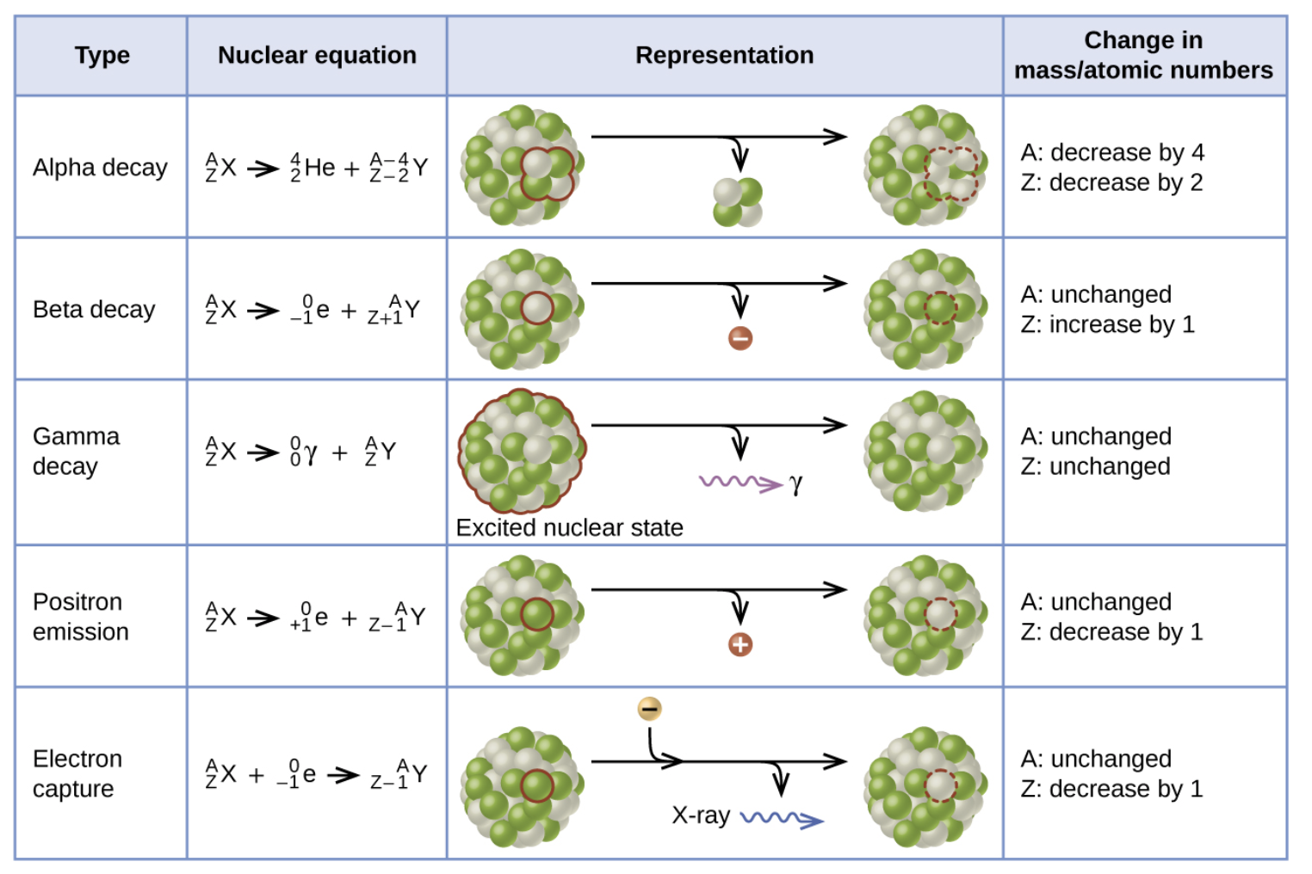
Types of Nuclear Reactions
Image Credit: OpenStax Chemistry Figure 21.4 CC BY 4.0

Slide 4
Positrons
Positron
Example of antimatter!
Like an electron but positively charged
Matter and antimatter will annihilate each other
When an electron meets its antiparticle, they annihilate production gamma rays
$${}_{-1}^{0}e+{}_{+1}^{0}e⟶γ+γ$$
Mass converted to energy
Can be calculated using: $E=mc^{2}$

Slide 5
Balancing Nuclear Reactions
In chemical reactions, we had to make sure that the number of each atom remained the same
In nuclear reactions, it is the number of nucleons that remains the same
Two things to balance:
The sum of the mass numbers of the products is the same as the sum of the mass numbers of the reactants
The sum of the charges of the products is the same as the sum of the charges of the reactants

Slide 6
Example
The reaction of an α-particle with magnesium-25 (${}_{12}^{25}Mg$) yields a proton and the nucleus of another element. What is the nucleus produced?
$${}_{12}^{25}Mg{}_{2}^{4}He$$
$${}_{12}^{25}Mg+_{2}^{4}He⟶_{1}^{1}H+_{Z}^{A}X$$
Balance mass number:
25 + 4 = 1 + A ; 29 = 1+ A ; A = 28
Balance charges:
12 + 2 = 1 + Z ; 14 = 1 + Z ; Z = 13
Z = 13 is aluminum
$${}_{12}^{25}Mg+_{2}^{4}He⟶_{1}^{1}H+_{13}^{28}Al$$

Slide 7
Example Nuclear Reactions from History (2)
1898: Marie Curie - first naturally occurring unstable element
$${}_{84}^{212}Po⟶_{82}^{208}Pb+_{2}^{4}He$$
1919: Ernest Rutherford - first nuclide created artificially
$${}_{7}^{14}N+_{2}^{4}He⟶_{8}^{17}O+_{1}^{1}H$$
1932: James Chadwick - discovery of the neutron
$${}_{4}^{9}Be+_{2}^{4}He⟶_{6}^{12}C+_{0}^{1}n$$

Slide 8
Example Nuclear Reactions from History
1937: Emilio Segre & Carlo Perrier - Produced technetium which does not occur naturally on Earth
$${}_{1}^{2}H+_{42}^{97}Mo⟶2_{0}^{1}n+_{43}^{97}Tc$$
1942: University of Chicago - controlled nuclear chain reaction
$${}_{92}^{235}U+_{0}^{1}n⟶_{35}^{87}Br+_{57}^{146}La+3_{0}^{1}n$$

Slide 9
Summary
Particle in nuclear reactions include nucleons - protons & neutrons. In addition, alpha particles (helium nuclei) and electrons and positrons can be involved
Nuclear reactions are balanced by balancing the mass number and the electrical charge of the reactants and products
We looked at several nuclear reactions that have been important in the history of nuclear chemistry

