Slide 1
Introduction to Physical Science
Radioactive Decay
Presented by Robert Wagner

Slide 2
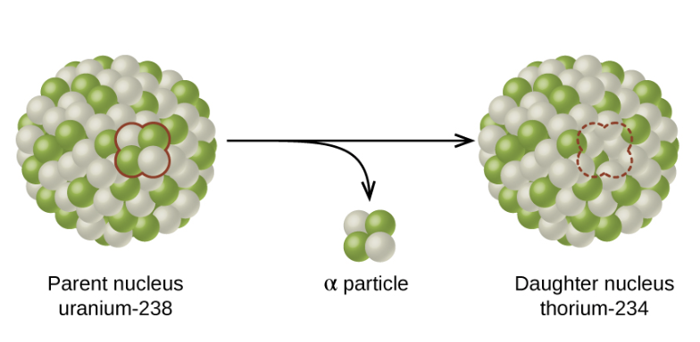
Radioactive Decay
The spontaneous change of an unstable nuclide into another
Parent nuclide: Unstable nuclide
Daughter nuclide: Result of the decay process
Daughter will lie closer to the band of stability - however, it may be stable or unstable itself
Image Credit: OpenStax Chemistry Figure 21.5 CC BY 4.0

Slide 3
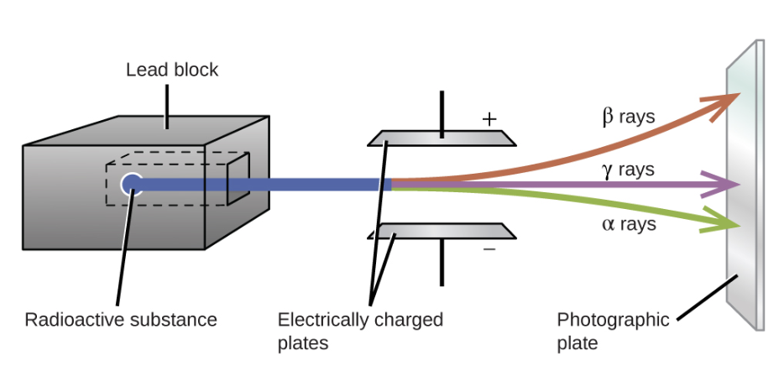
Types of Radioactive Decay Particles
α-particles - helium nucleus
Positively charged
Β-particles - electron
Negatively charged
γ-rays - electromagnetic waves
No charge
Image Credit: OpenStax Chemistry Figure 21.6 CC BY 4.0

Slide 4
Types of Radioactive Decay
Gamma (γ) emission
Nucleus is in an excited state
Positron (β⁺) emission
Emission of a positron from a nucleus
Occurs when there is a small neutron to proton ratio
Electron capture
Inner electron is captured
Combines with a proton to form a neutron
Alpha(α) decay
Emission of an alpha particle from the nucleus
Primarily occurs with very heavy nuclei
Beta (β) decay
Neutron converted into a proton and an electron (beta particle)
Occurs when there is a large neutron to proton ratio

Slide 5
Types of Radioactive Decay (Examples)
Alpha(α) decay
$${}_{84}^{210}Po⟶_{2}^{4}He+_{82}^{206}Pb$$
Beta (β) decay
$${}_{53}^{131}I⟶_{-1}^{0}e+{}_{54}^{131}Xe$$
Gamma (γ) emission
$${}_{27}^{60}Co^{*}⟶_{0}^{0}γ+{}_{27}^{60}Co$$
Positron (β⁺) emission
$${}_{8}^{15}O⟶_{+1}^{0}e+_{7}^{15}N$$
Electron capture
$${}_{19}^{40}K+{}_{-1}^{0}e⟶_{18}^{40}Ar$$

Slide 6
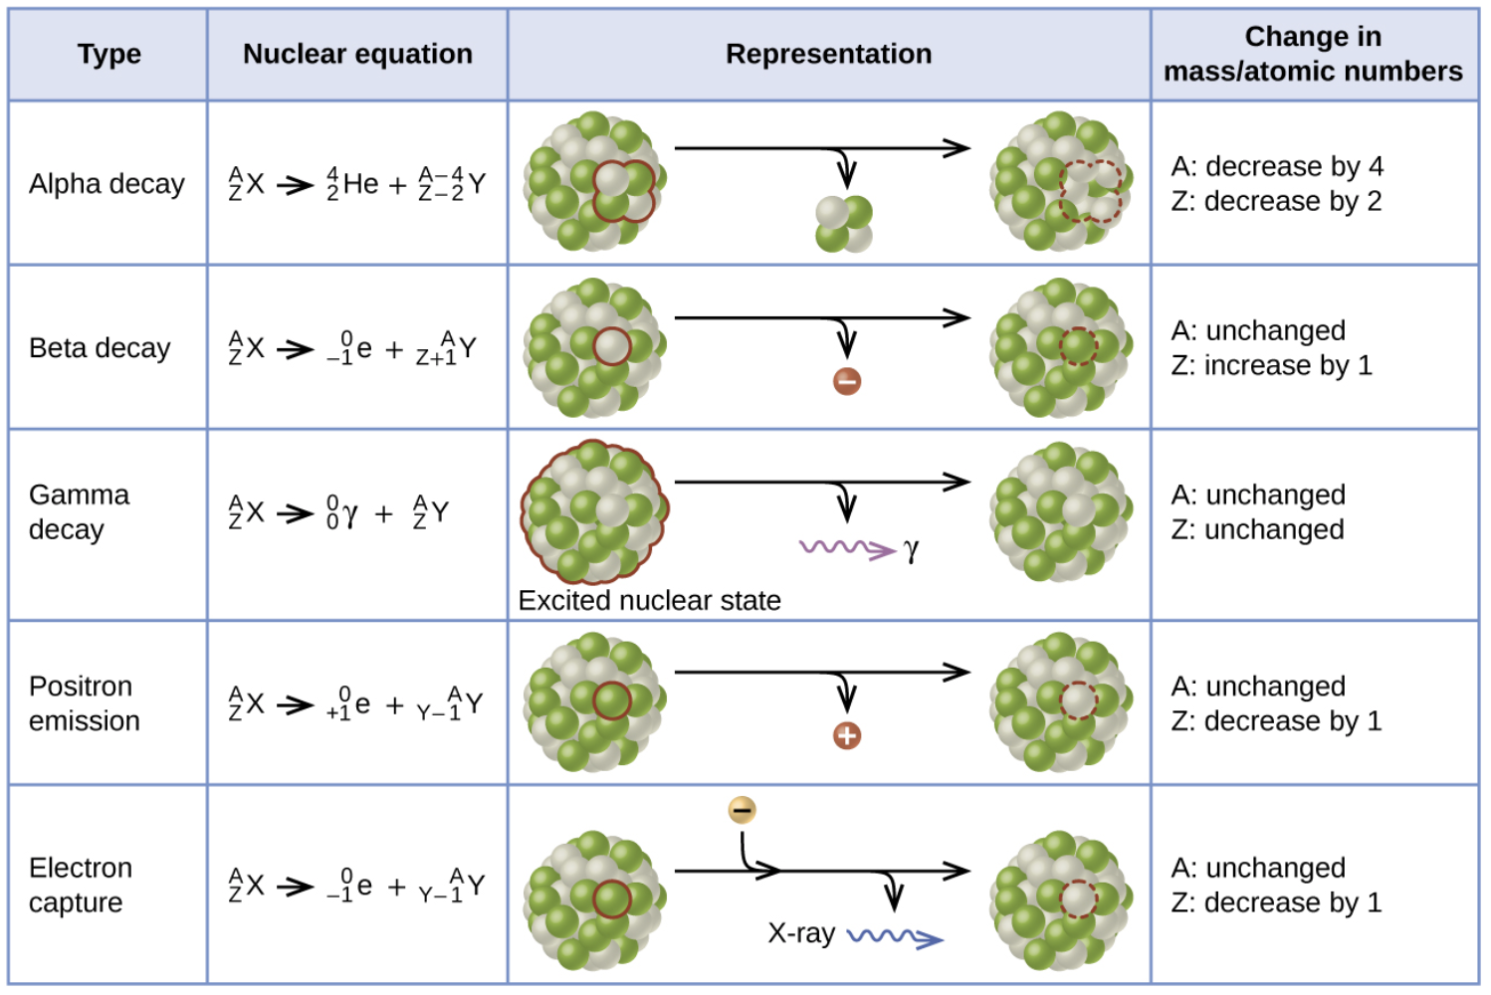
Types of Radioactive Decay (Chart)
Image Credit: OpenStax Chemistry Figure 21.7 CC BY 4.0

Slide 7
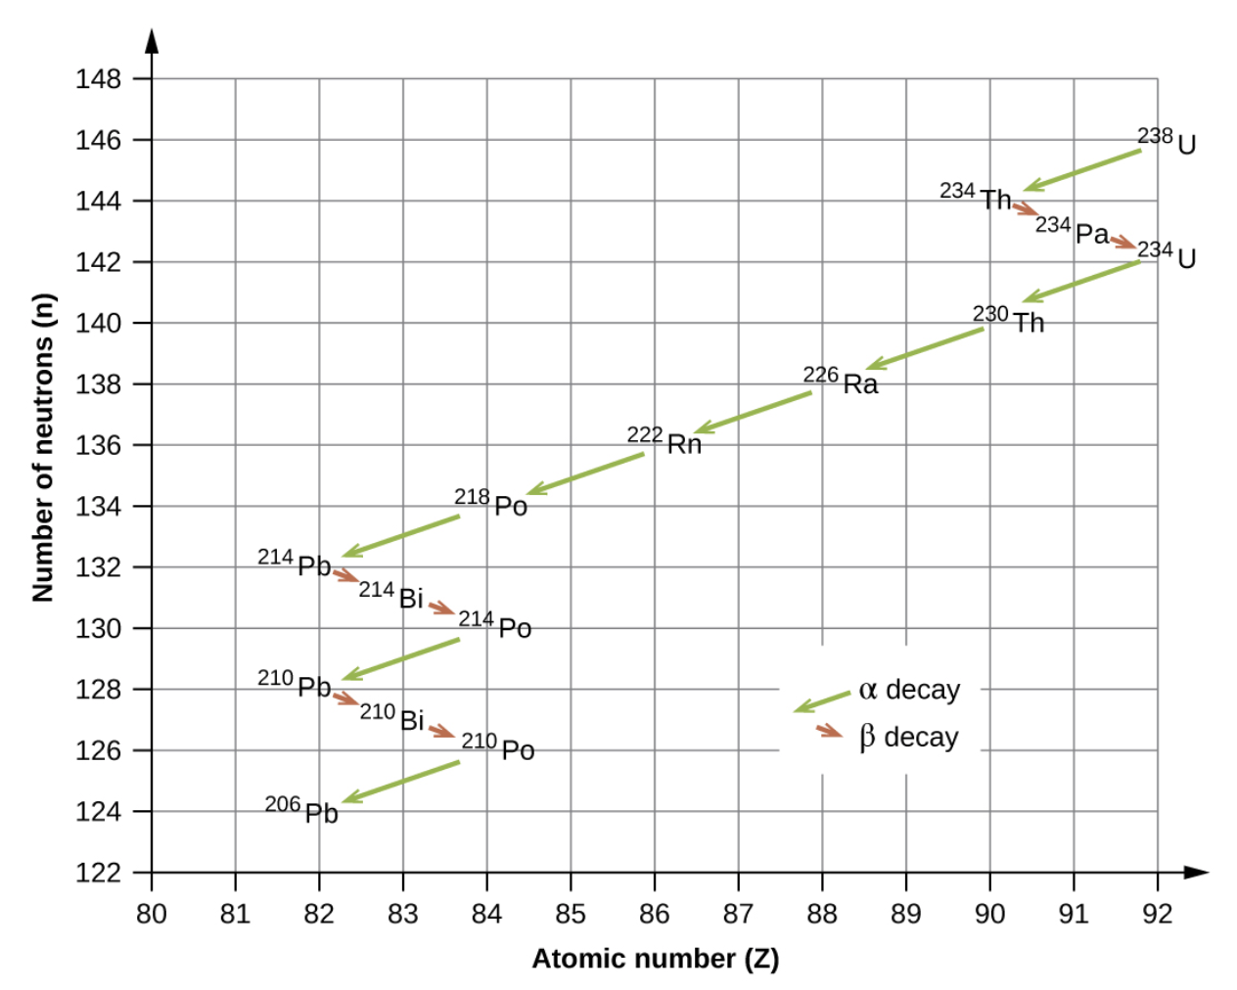
Radioactive Decay Series
A chain of successive disintegrations
Form a radioactive family or radioactive decay series
Ultimately leads to a stable end product
Example series
Uranium series
Actinide series
Thorium series
Image Credit: OpenStax Chemistry Figure 21.9 CC BY 4.0

Slide 8
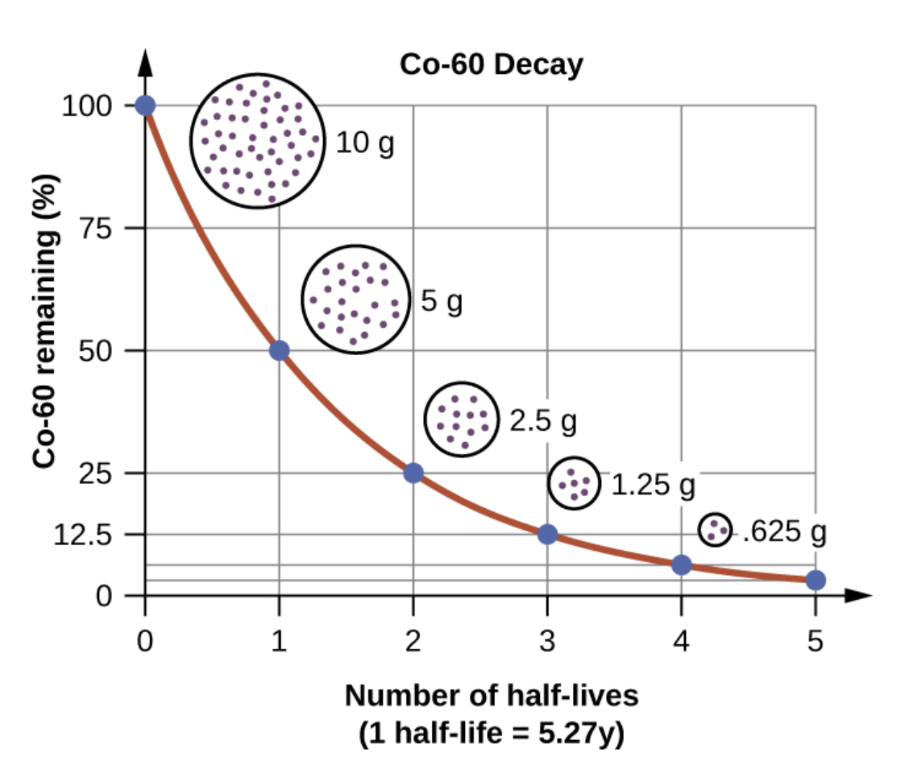
Radioactive Half-Lives
Each radioactive nucleus has a characteristic half-life
Amount of time it takes from one half of the radioactive material to decay
Half-life calculations can be done using natural logarithms and exponentials
We will look at other methods for this class
Image Credit: OpenStax Chemistry Figure 21.10 CC BY 4.0

Slide 9
Example
How long will it take 20g of Cobalt-60 (Half-life = 5.27 years) to decay into 5g?
How much would be left if we wait the same additional amount of time after the first decay from 20g -> 5g?
When would the ratio of daughter to parent by about 5:1?
20g of Co-60 ; Half-life= 5.27 years
Time | Parent | Daughter | Ratio
0 yr | 20g | 0g | 0
5.27 yr | 10g | 10g | 1:1
10.54 yr | 5g | 15g | 3:1
15.81 yr | 2.5g | 17.5g | 7:1
21.08 yr | 1.25g | 18.75g | 15:1
26.35 yr | 0.625g | 19.375g | 31:1

Slide 10
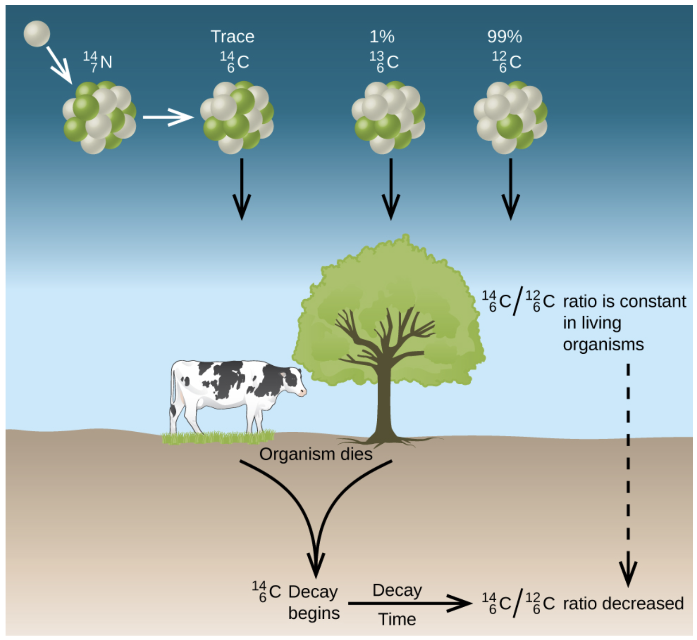
Radiometric Dating
Can use this to determine ages of objects that contain radioactive materials
Carbon-14 dating
Carbon-14 forms in the atmosphere from the interaction of nitrogen with cosmic rays
$${}_{7}^{14}N+{}_{0}^{1}n⟶_{6}^{14}C+{}_{1}^{1}H$$
Carbon-14 is incorporated into living organisms as the carbon
Decays with a half-life of 5730 years
Image Credit: OpenStax Chemistry Figure 21.11 CC BY 4.0

Slide 11
Radiometric Dating (2)
Can only use Carbon-14 dating for things containing carbon
Half-life would be too short to date things like rocks
Use other methods to date rocky materials
U-238:Pb-206 (4.5 billion year half-life)
K-40:Ar-40 (1.25 billion year half-life)

Slide 12
Example
A moon rock is found to have a Ar-40:K-40 ratio of 11:1. Approximately how old is the rock?
Start with 100g of K-40.
100g of K-40 ; Half-life= 1.25 billion years
Half-lives | Time | Parent | Daughter | Ratio
0 | 0 yr | 100g | 0g | 0
1 | 1.25 Gyr | 50g | 50g | 1:1
2 | 2.50 Gyr | 25g | 75g | 3:1
3 | 3.75 Gyr | 12.5g | 87.5g | 7:1
4 | 5.00 Gyr | 6.25g | 93.75g | 15:1
5 | 6.25 Gyr | 3.125g | 96.875g | 31:1

Slide 13
Summary
Radioactive nuclei will spontaneously decay into to other nuclei
We considered five different types of radioactive decay (alpha, beta, gamma, electron capture, & positron emission)
Radioactive materials have half-lives which can be used to determine ages of objects

