Slide 1
Introduction to Physical Science
Nuclear Energy
Presented by Robert Wagner

Slide 2
Nuclear Transmutation
The conversion of one nuclide to another
Example:
$${}_{7}^{14}N+_{2}^{4}He⟶_{8}^{17}O+_{1}^{1}H$$
Requires very high energies
Particle accelerators can be used

Slide 3
Transuranium Elements
Uranium (Z=92) is the heaviest naturally occurring element
Heavier elements can be produced artificially
Bombard uranium-238 with neutrons:
$${}_{92}^{238}U+_{0}^{1}n⟶_{92}^{239}U$$
Decays
${}_{92}^{239}U⟶_{93}^{239}Np+_{-1}^{0}e$ Half life = 23.5min
${}_{92}^{239}Np⟶_{94}^{239}Pu+_{-1}^{0}e$ Half life = 2.36 days

Slide 4
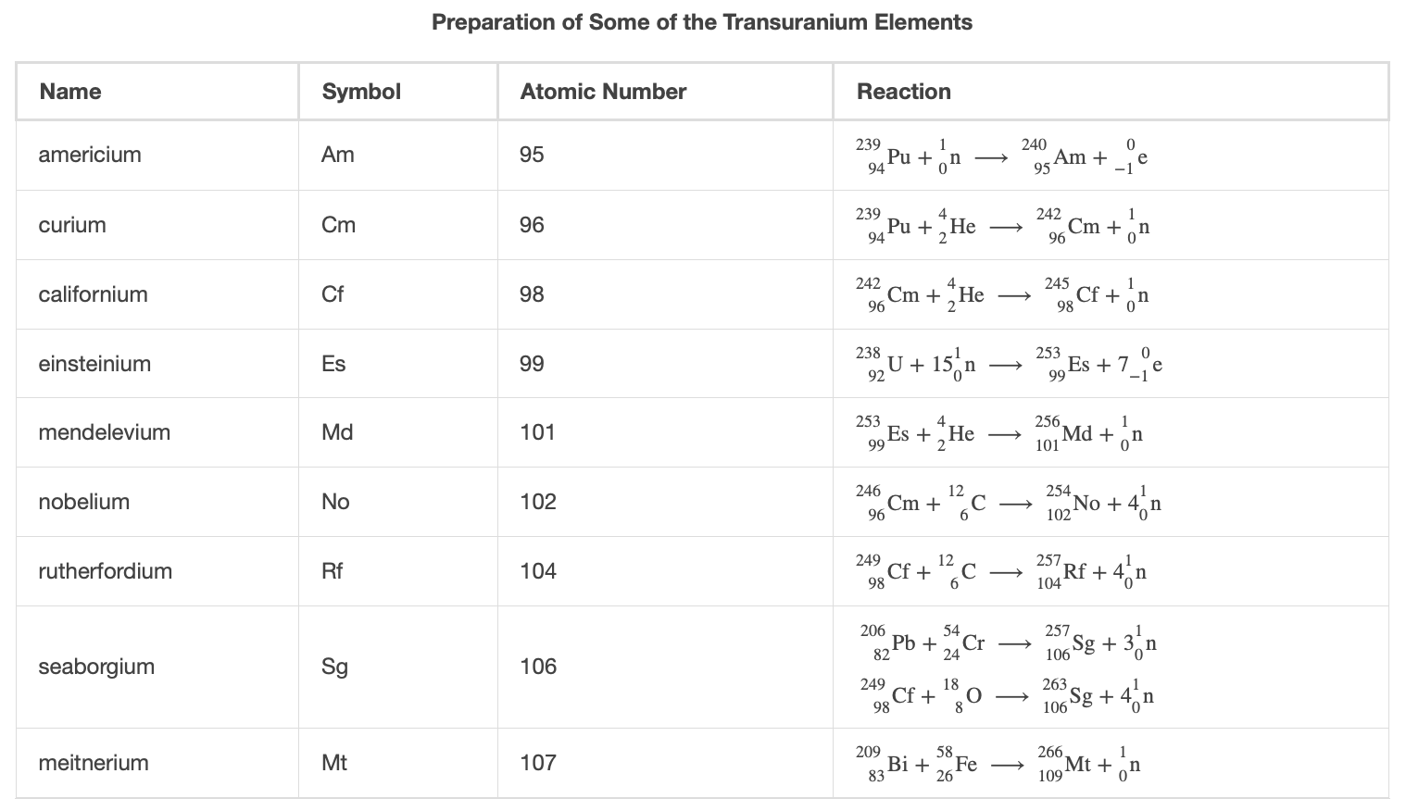
Transuranium Elements (2)
Image Credit: OpenStax Chemistry Table 21.3 CC BY 4.0

Slide 5
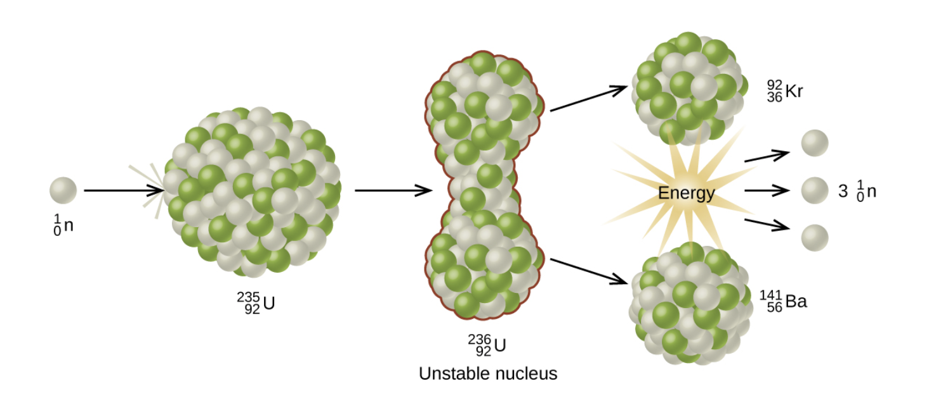
Nuclear Fission
Heavier elements can decompose into more stable elements with lower masses
Usually does not occur naturally
Bombardment with neutrons
$${}_{92}^{235}U+_{0}^{1}n⟶_{92}^{236}U⟶_{56}^{141}Ba+_{36}^{92}Kr+3_{0}^{1}n$$
Mass difference between products and reactants yields energy
$$E=mc^{2}$$
Image Credit: OpenStax Chemistry Figure 21.14 CC BY 4.0

Slide 6
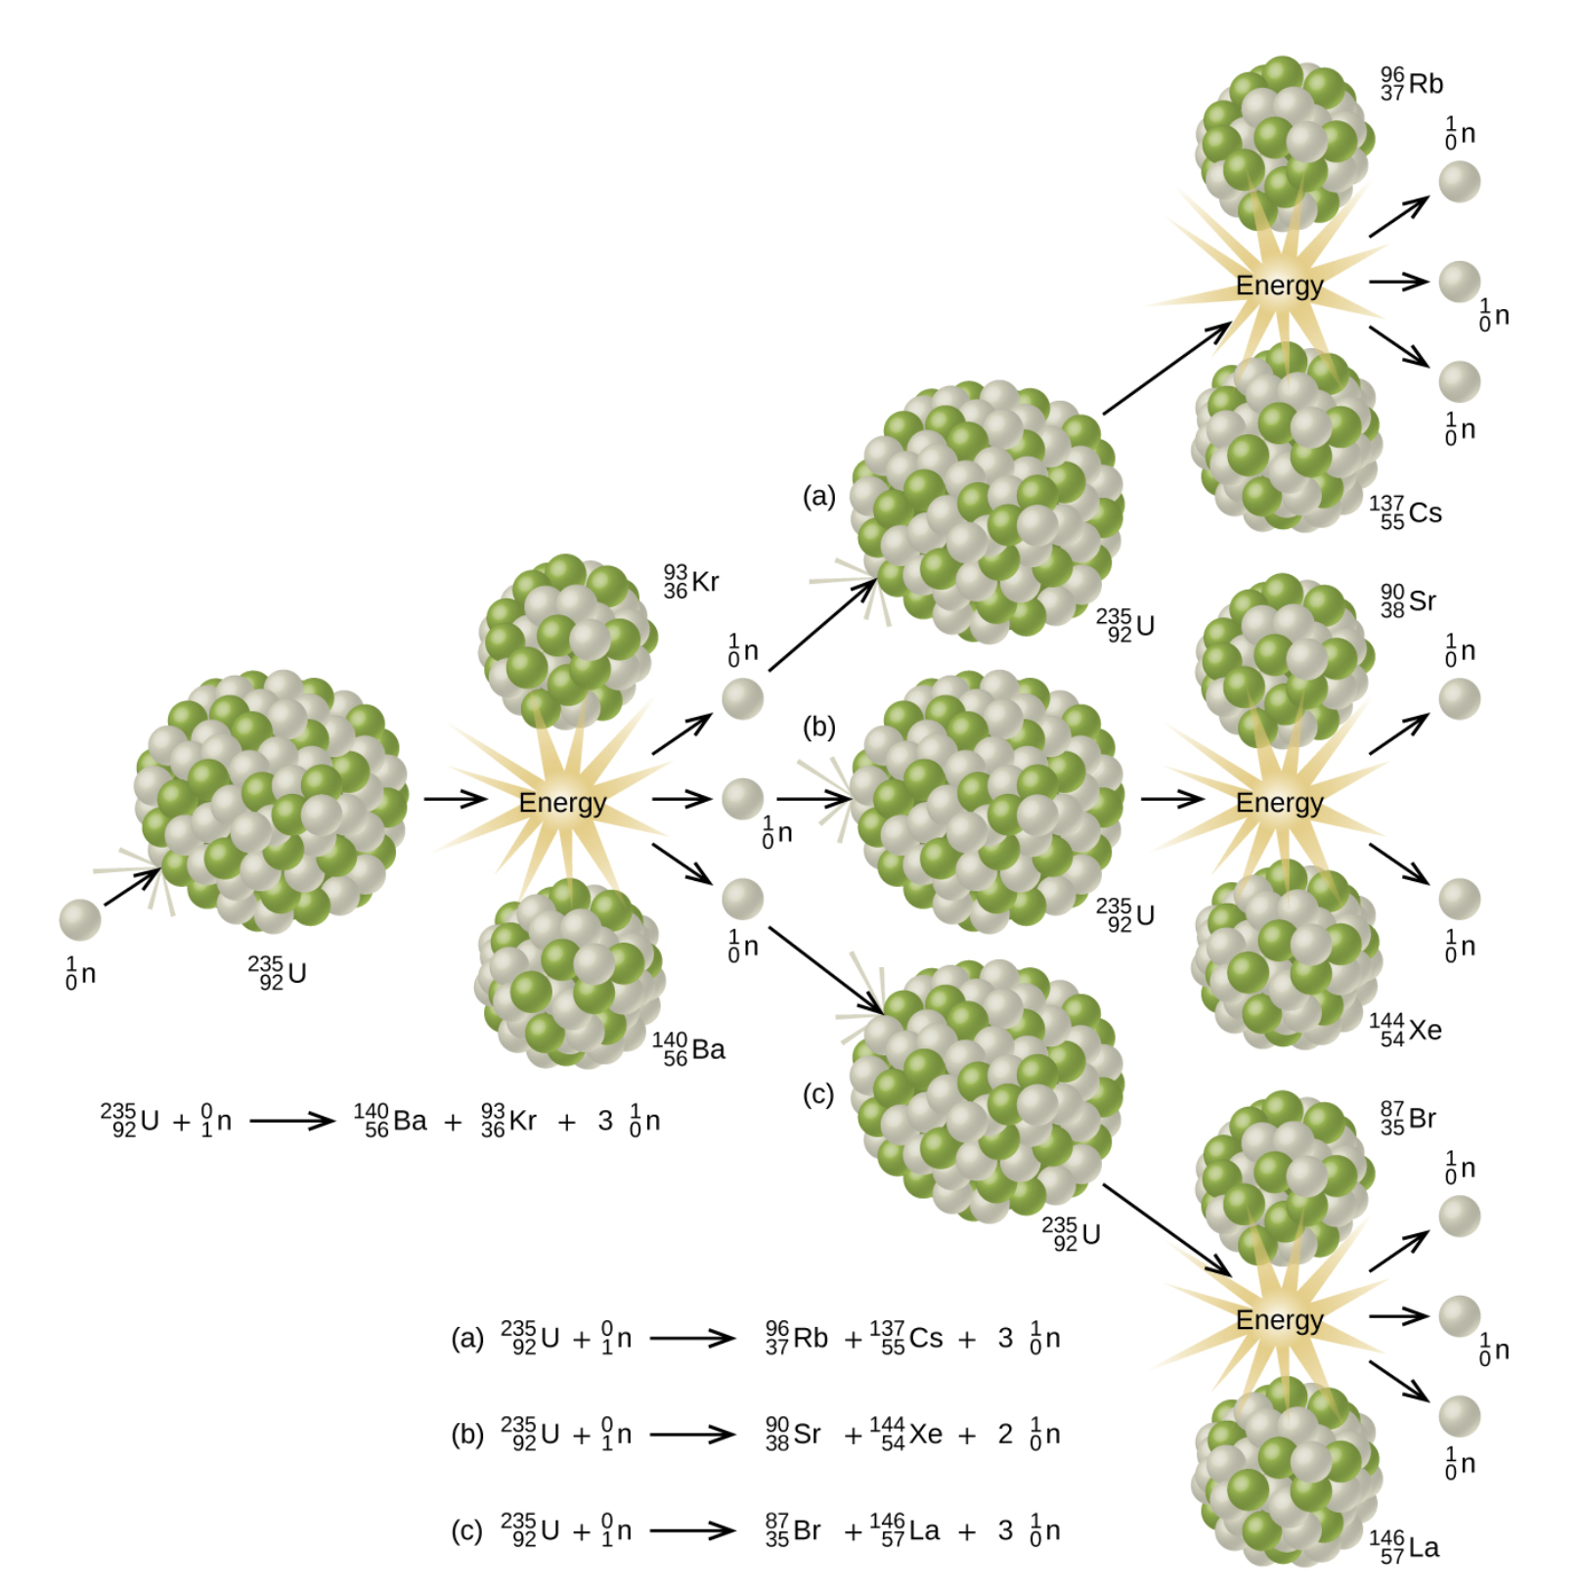
Critical Mass
Free neutrons are produced in a fission reaction
These can cause fission of other nuclei
Fissile or fissionable material is material that is capable of sustaining a nuclear chain reaction
A critics mass of material is needed
Number of neutrons produced exceeds the number of neutrons absorbed
Image Credit: OpenStax Chemistry Figure 21.16 CC BY 4.0

Slide 7
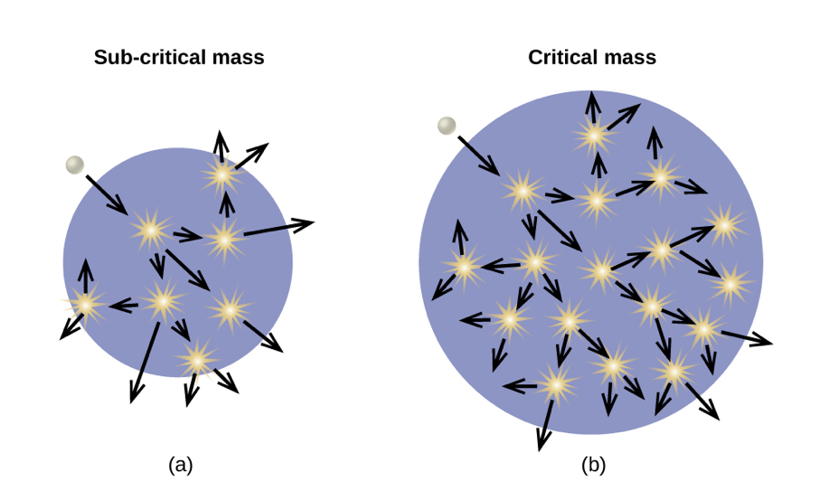
Critical Mass
Free neutrons are produced in a fission reaction
These can cause fission of other nuclei
Fissile or fissionable material is material that is capable of sustaining a nuclear chain reaction
A critics mass of material is needed
Number of neutrons produced exceeds the number of neutrons absorbed
Image Credit: OpenStax Chemistry Figure 21.17 CC BY 4.0

Slide 8
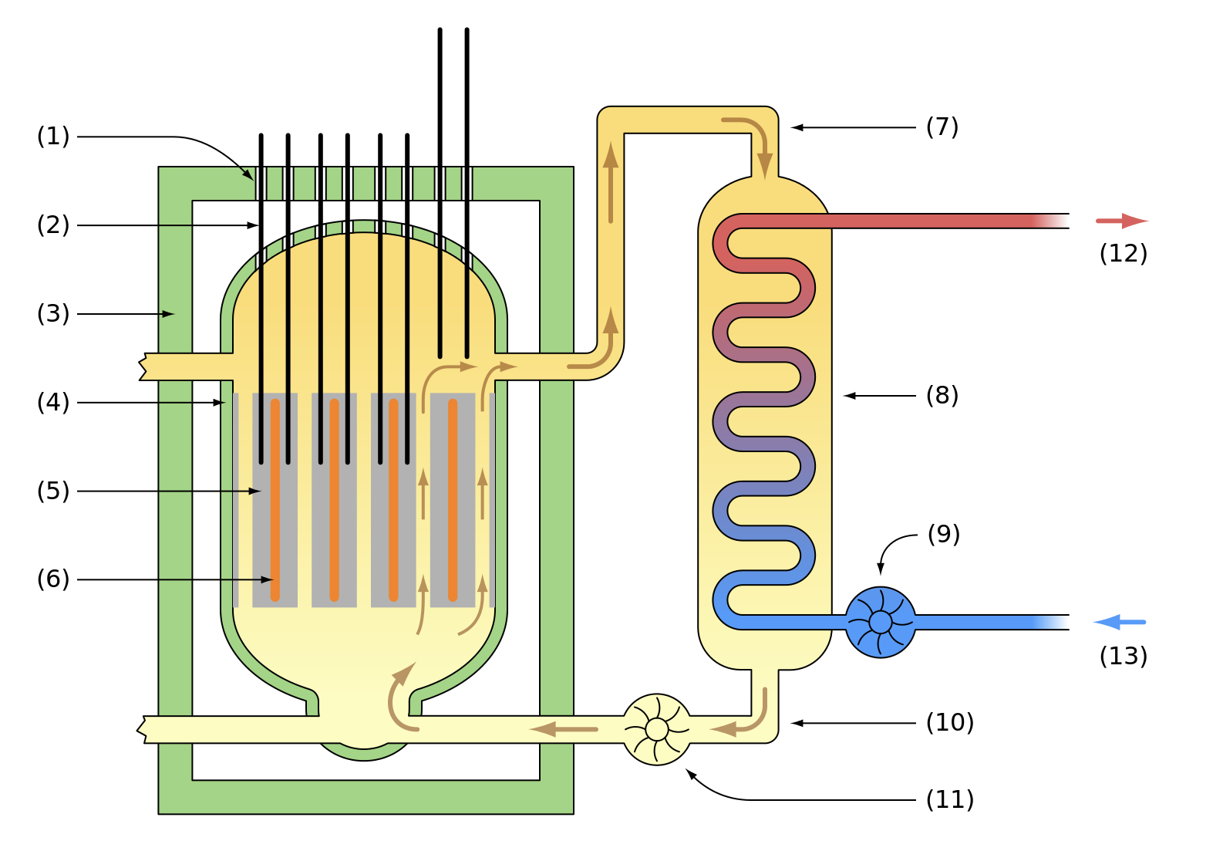
Fission Reactors
Controllable chain reactions
Nuclear fuel
Example: Uranium-235 (<1% of naturally occurring)
Enriched to 5% or so
Allows a chain reaction
Does not allow for a supercritical mass - no explosion
Control rods - absorb neutrons to control rate of reaction
Image Credit: Emoscopes, CC BY 2.5 <http://creativecommons.org/licenses/by/2.5/>, via Wikimedia Commons

Slide 9
Fusion Reactions
Converting light nuclei into heavier nuclei
Energy source of our Sun
$$4_{1}^{1}H⟶_{2}^{4}He+2_{+1}^{0}e^{+}$$
The mass difference is converted to energy:
$$E=mc^{2}$$
Requires very high temperatures
10-15 million Kelvin
Nuclear weapon - Hydrogen bomb
Nuclear power - need a way to contain the material - magnetic fields? Focused laser beams? Current research is ongoing…

Slide 10
Summary
The transmutation of elements can produce energy
Nuclear fission splits heavier elements into lighter ones
Nuclear fusion combines lighter elements into heavier ones

